Slide 1
Recursion

Slide 2
Recursion
What do you think the behaviour of these two functions if they are called with 10?
void fun(int i){
if(i==0)
return;
fun(i-1);
cout<<i<<'\n';
}
void fun(int i){
if(i==0)
return;
cout<<i<<'\n';
fun(i-1);
}

Slide 3
Recursion
Recursion is the process in which a function calls itself.
Recursion is the process of defining a problem (or the solution to a problem) in terms of (a simpler version of) itself.
Stack plays an important rule with recursion to keep track the function calls

Slide 4
Recursion
To Write a recursive function, you need to think about two things:
The recursion logic (The transition): How to get the answer of the current problem from the answer(s) of simpler version(s) of it
The base case(s): When this recursion will end

Slide 5
Recursion: Example 1
Write a recursive code to implement the power function of integer base and power
base=2, exponent=3
power(2,3)=8
base=3, exponent=4
power(3,4)=81

Slide 6
Recursion: Example 1
The recursion logic (The transition):
If I have the answer of the same problem but in previous version power(base, exponent-1), I can get the answer for the current version power(base, exponent)
power(base, exponent) =base * power(base, exponent-1)
2^4 = 2 * 2^3
The base case:
When I get to the version where exponent=0, the answer is 1

Slide 7
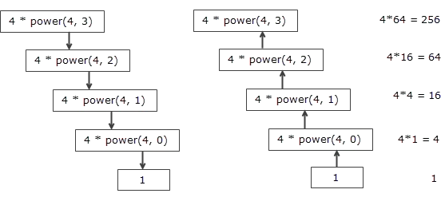
Recursion: Example 1
int power(int base, int exponent){
// base case
if(exponent==0) return 1;
// Transition
return base * power(base, exponent-1);
}

Slide 8
Recursion: Example 2
Write a recursive code to calculate the n-th (zero based) fibonacci number.
0, 1, 1, 2, 3, 5, 8, 13, 21, 34, 55, 89, 144, …
n=0 → fib(0) = 0
n=3 → fib(3) = 2
n=6 → fib(6) = 8

Slide 9
Recursion: Example 2
The recursion logic (The transition):
If I have the answers of fib (same problem) for the previous two versions (n-1&n-2), I can get the answer for the current version (n)
fib(n)=fib(n-1)+fib(n-2)
The base case(s):
When I get to the version where n=0, the answer is 0
When I get to the version where n=1, the answer is 1

Slide 10
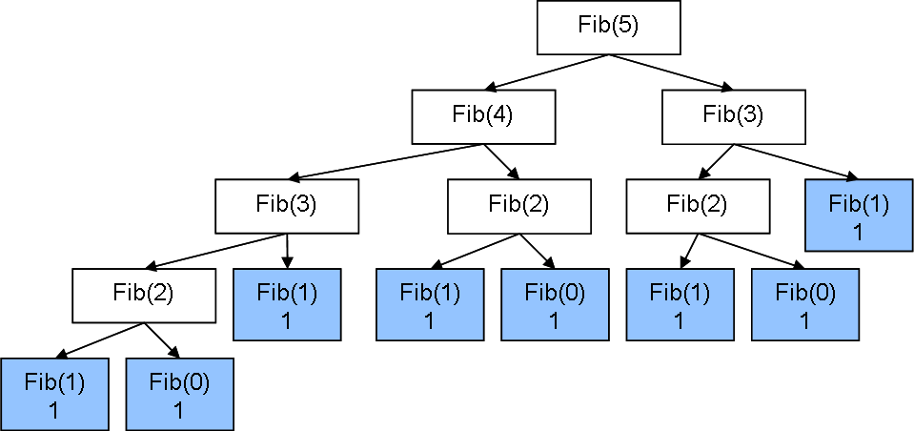
Recursion: Example 2
int fib(int n){
// base cases
if(n==0) return 0;
if(n==1) return 1;
// Transition
return fib(n-1)+fib(n-2);
}

Slide 11
To Solve
Hello Recursion
Recursive Digit Sum
Merge Two Sorted Lists
Invert Binary Tree

